Slide 1
Power Management and Low Power Design for Embedded Processors (II)
Lecture 7

Slide 2
Outline
Embedded Processor
  Low Power Design Considerations
    RISC and code density
    Low power and power management
Embedded OS

Slide 3
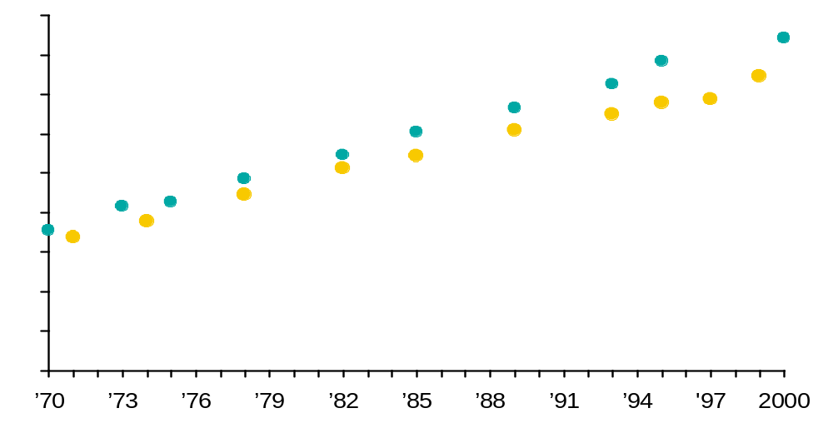
Moore’s Law
For many years technology obeys Moore’s Law
Transistors
Per Die
10⁸
256M
Memory
64M
10⁷
16M
Pentium® III
Microprocessor
4M
10⁶
1M
Pentium® II
256K
Pentium® Pro
10⁵
Pentium®
64K
i486™
10⁴
4K
16K
i386™
80286
1K
8086
10³
8080
4004
10²
10¹
10⁰
Source: Intel

Slide 4
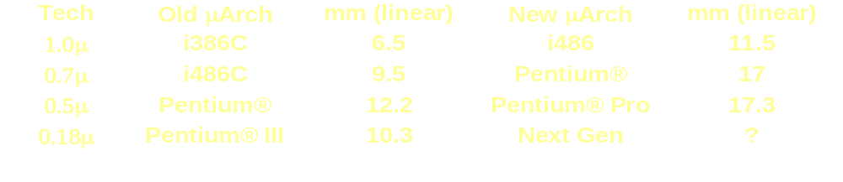
In the Last 25 Years Life was Easy^{(*)}
Doubling of transistor density every 30 months
Increasing die sizes, allowed by
  Increasing Wafer Size
  Process technology moving from “black art” to “manufacturing science”
⇒ Doubling of transistors every 18 months
Implications: (in the same technology)
1. New μArch ~ 2-3X die area of the last μArch
2. Provides 1.5-1.7X integer performance of the last μArch
(*) source Fred Pollack, Micro-32

Slide 5

Suddenly, the power monster appears

Slide 6
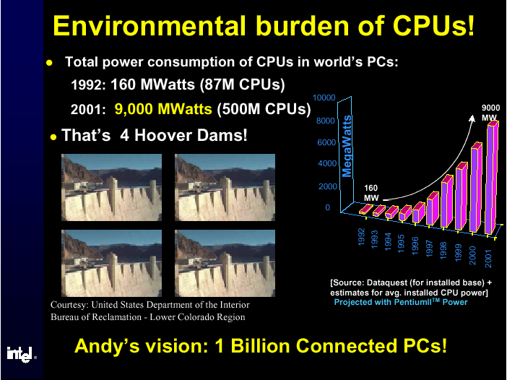
The power crisis – power consumption
^{Sourse: cool-chips, Micro 32}

Slide 7
Transistors on a chip trend
1000000000
100000000
P-IV
P-III
10000000
486
P-II
1000000
P-I
386
286
100000
8086
Transistors
8008
8080
10000
Moore’s Law
1000
4004
100
10
1
1968
1970
1972
1974
1976
1978
1980
1982
1984
1986
1988
1990
1992
1994
1996
1998
2000

Slide 8
Transistors on a chip trend
100
?
Pentium® II
Pentium® Pro
Pentium® 4
Pentium® III
10
Max Power (Watts)
Pentium®
Pentium®
w/MMX tech.
i486
i386
1
1.5μ
1μ
0.8μ
0.6μ
0.35μ
0.25μ
0.18μ
0.13μ

Slide 9
The power crisis: Power Density
A real thread to the Moor law
Think of watts/cm²
Power is not distributed evenly over the chip. A failure can happen if a single point reach the max power point.
Complex algorithms lead to denser power:
  Dense random logic
Timing pressure leads to faster/bigger/power-hungrier gates
  Designers put together units that communicate with each other. It creates “regions” with high activity factors -> hot spots.

Slide 10
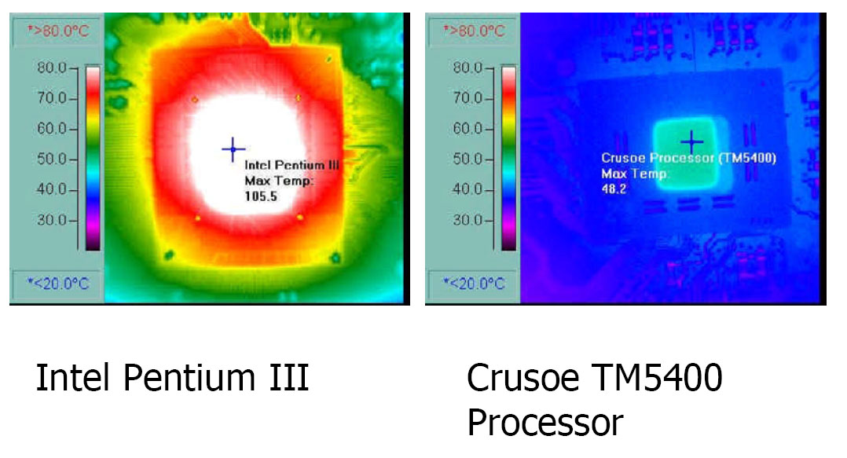
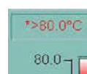
Thermal Comparison

Slide 11



Power Density
Sun's
Surface
1000
Rocket
Nozzle
Nuclear Reactor
2
100
Pentium® 4
Watts/cm
Hot plate
Pentium® III
10
Pentium® II
Pentium® Pro
i386
Pentium®
i486
1
1.5μ
1μ
0.7μ
0.5μ
0.35μ
0.25μ
0.18μ
0.13μ
0.1μ
0.07μ
* “New Microarchitecture Challenges in the Coming Generations of CMOS Process Technologies” – Fred Pollack, Intel Corp. Micro32 conference key note - 1999.

Slide 12
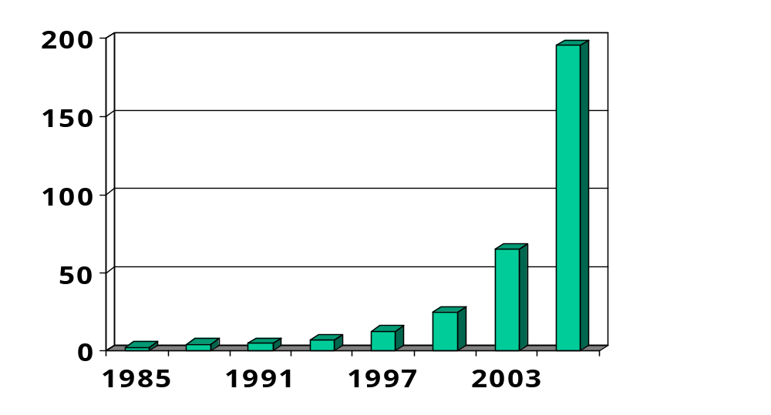
Chip power dissipation trend
Power (Watts)
Expected power consumption increase over the next 5 years is 300-400%

Slide 13
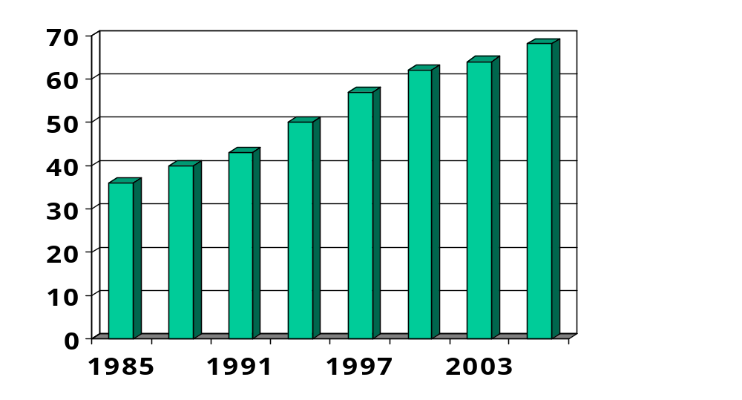
Battery energy density trend
Energy (KJ per lb)
Expected energy density increase over the next 5 years is 30-40%

Slide 14
Embedded Processor Support for Low Power Design
CMOS power components
  Switching power
    Dissipated by charging and discharging the gate output capacitance
  Short-circuit power
    Transitory conducting path from Vdd to Vss
  Leakage current
    The transistor networks do conduct a very small current when they are in their off state

Slide 15

Power and the digital world…
Power is consumed:
  When capacitance is charged and discharged
  A charged cap is a logical ‘1’, a discharged cap is ‘0’
The capacitance can be the gates of other transistors or wires (buses and long interconnects)
E=CV²
IN
OUT
0
1
1
0

Slide 16
Power and the digital world (2)…
Secondary effects like leakage and short-circuit current are
increasing with advanced process technologies
Leakage is growing dramatically
  7% now, expect 20% in next process technology, 50% in next one
  … Unless we do something (and we will)
IN
OUT
IN
OUT
0
1
1/2
Leakage
(sub-threshold)
Short-circuit

Slide 17

Power & Energy
Energy
“The capacity for doing work” *
Important for
  Battery life - lower energy per task ➔ longer battery life
  Electric bills - lower energy per task ➔ lower bills
Measured over time
Proportional to the overall capacitance and to the voltage squared (CV²)
* Merriam-Webster’s Collegiate® Dictionary - http://www.m-w.com/

Slide 18
Low power and power management
Power vs. energy
Power (Watt) is a rate of energy (Joule) consumption
  3 Watt × 12 sec. = 36 Joules
  Energy is the integral of power over time, P × T
A battery has ? amount of energy
A transistor dissipates energy on a state transition 0 to 1 or 1 to 0.
More transistors ➔ more transitions ➔ more energy dissipation

Slide 19
CPU power consumption
Most modern CPUs are designed with power consumption in mind to some degree.
Power vs. energy:
  heat depends on power consumption;
  battery life depends on energy consumption.

Slide 20

Energy
unit is Joule (J)
  1 J is equal to 1 kg m²/s².
  Kinetic energy (movement energy):
Heat is an amount of energy which is usually linked with a change in temperature or in a change in phase of matter.
Work is a measure of energy expended in applying force over a distance.
  f(x) gives the amount of force being applied as a function of the distance moved, x.

Slide 21
Power management styles
Static power management: does not depend on CPU activity.
  Example: user-activated power-down mode.
Dynamic power management: based on CPU activity.
  Automatic, no program intervention
  Example: disabling off function units.

Slide 22
Embedded Processor Support for Low Power Design
Complementary metal oxide semiconductor. Pronounced see-moss (CMOS)
  is a widely used type of semiconductor.
  CMOS semiconductors use both NMOS (negative polarity) and PMOS (positive polarity) circuits.
  attractive for use in battery-powered devices, such as portable computers. Personal computers also contain a small amount of battery-powered CMOS memory to hold the date, time, and system setup parameters.
Notes:
Since only one of the circuit types is on at any given time, CMOS chips require less power than chips using just one type of transistor. This makes them particularly
Note that the N-type transistor is conducting when its input is '1', while the P-type transistor is conducting when its input is '0'.

Slide 23
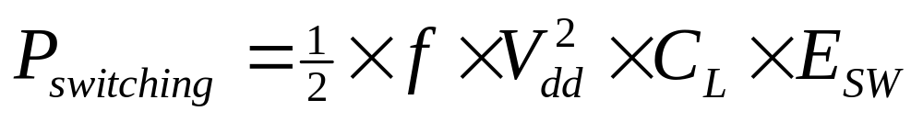
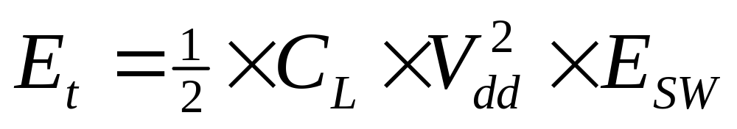
Embedded Processor Support for Low Power Design
CMOS switching power
  P_{switching}: power dissipation of CMOS while switching.
  f: clock frequency.
  E_{sw}: switching activity of the gate.
  C_{L}: gate load capacitance.

Slide 24
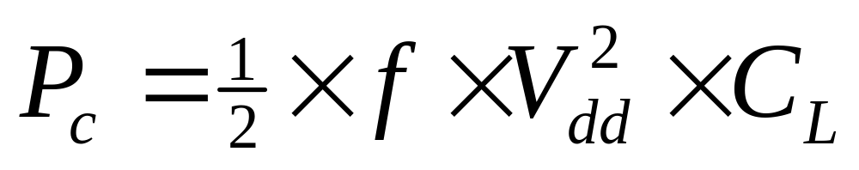
CMOS power consumption
CMOS Power Consumption
  Consider dynamic power
  Negligible static power dissipation

Slide 25
CMOS power consumption
Voltage drops: power consumption proportional to V².
  Limited by threshold voltage & noise margins
Toggling: more activity means more power.
Leakage: basic circuit characteristics; can be eliminated by disconnecting power.

Slide 26
CPU power-saving strategies
Reduce power supply voltage.
Run at lower clock frequency.
Disable function units with control signals when not in use.
Disconnect parts from power supply when not in use.

Slide 27
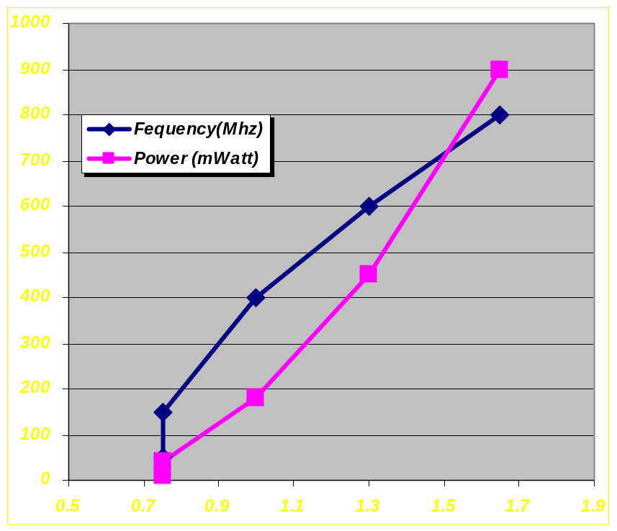
Voltage Scaling
Within a given voltage range, higher voltage allows higher freq.
Used for trading power and frequency. Either
  Statically, at manufacturing time
  Dynamically, at run time (e.g., Intel’s SpeedStep® Technology
Actual range depends on specific
design and process technology
Examples*:
  Intel® XScale™ processors runs
  from 0.75V (150MHz/50mW)
  to 1.65V (800MHz/900mW)
  Intel mobile Pentium® III processor
  sells from 1.1V (600MHz)
  to 1.7V (1GHz)
XScale proc. freq & power vs voltage
* Source: Intel Corp. (http://developer.intel.com)

Slide 28
Low power techniques?
Hardware to support power management capabilities
  Power modes
  Dynamical voltage scaling
  Adaptive caches
Software to be resource aware
  OS
  Applications
  Compiler

Slide 29
CPU power modes
μP can be switched to operate at different modes
  Running: max power
  Idle: low power, state intact, quick recovery
  Sleep: ultra low power, state intact, takes longer to recover
  Deep sleep: minimum power, portions of state intact, takes even longer to recover

Slide 30
Embedded Processor Support for Low Power Design
ARM7100
  For battery powered device
  Full operation mode
    14 MIPS
    24mA
    3.0V
  Idle mode
    33mW
  Standby mode
    32kHz
    33uW
ARM9TDMI
  0.35um at 3.3V
  0.25um or 0.18um at 1.2V

Slide 31
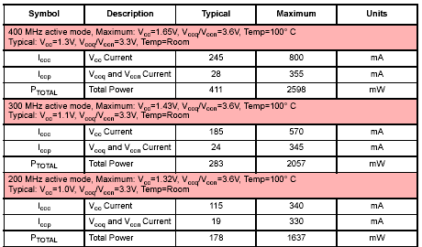
Xscale PXA 255 power mode

Slide 32
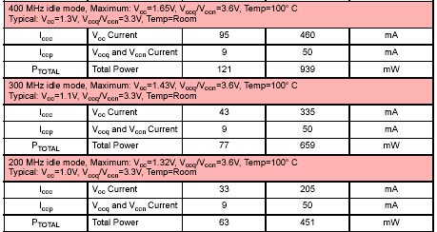
Xscale PXA 255 power mode

Slide 33
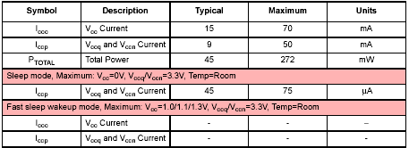
Xscale PXA 255 power mode

Slide 34
Xscale PXA 255 power mode
Turbo Mode: the Core runs at its peak frequency. In this mode, make very few external memory accesses because the Core must wait on the external memory
Run Mode: the Core runs at its normal frequency. In this mode, the Core is assumed to be doing frequent external memory accesses, so running slower is optimum for the best power/performance trade-off.
Idle Mode: the Core is not being clocked, but the rest of the system is fully operational. This mode is used during brief lulls in activity, when the external system must continue operation but the Core is idle.
Sleep Mode: places the processor in its lowest power state but maintains I/O state, RTC, and the Clocks and Power Manager. Wake-up from Sleep Mode requires re-booting the system, since most internal state was lost. The core power must be grounded in sleep to prevent current leakage.
Notes:
In Turbo mode: the memory access frequency is half of the processor clock frequency.

Slide 35
Xscale PXA 255 power mode
Power Mode Register (PWRMODE)
  PWRMODE register is used to enter turbo, run, idle and sleep mode.
Power Manager Control Register (PMCR)
  The PMCR is used to select the manner in which Sleep Mode is entered when the nVDD_FAULT or the nBATT_FAULT pin is asserted low.
  When the IDAE bit is set,
    an Imprecise Data Abort indication is sent to the CPU. The operating system then performs an abort routine.
    Software must ensure that the abort routine sets the Sleep Mode configuration in the PWRMODE register.
  When the IDAE bit is clear, CPU immediate entries to sleep mode when
  The IDAE bit is cleared in any Reset and when Sleep Mode exits. Software may also clear the IDAE bit when necessary.

Slide 36
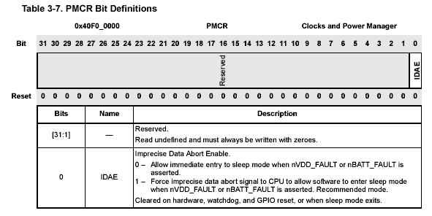
Xscale PXA 255 power mode

Slide 37
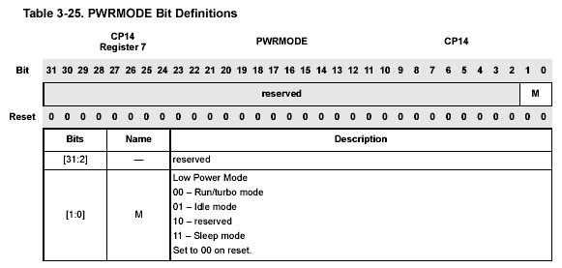
Xscale PXA 255 power mode

Slide 38
Dynamic voltage scaling (DVS)
In CMOS, reduction in V means quadratic reduction in P
  P ∝ V ²
In CMOS, reduction in V means near-linear reduction in circuit delay D
  D ∝ 1 / V
By computing at low V, we reduce energy
  E = P × D
  E ∝ V

Slide 39
DVS hardware
Frequency
controlled
DC/DC
converter
μP
V_{max}
V
f_{max}
Frequency divider
f
Desired frequency
Speed reg.

Slide 40
DVS software
Task/voltage scheduling
  Meeting deadlines
  Reducing power
On each context switch
  Choose the next task
  Set appropriate μP speed
Modified EDF (dynamic)
Fine grained voltage scheduling done by compiler (static)
  Basic block
  Loop, …
T1
T3
E = 194
Speed (MHz)
T2
Time (sec)
T2
E = 218
Speed (MHz)
T3
T1
Time (sec)

Slide 41
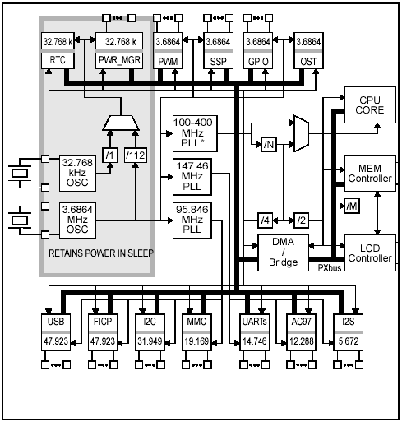
Xscale PXA 255 DVS setting

Slide 42
Xscale PXA 255 DVS setting
32.768 kHz Oscillator:
  Is a low power, low frequency oscillator
  Clocks the RTC and Power manager.
3.6864 MHz Oscillator:
  Provides the primary clock for the processor.
  Is disabled during the sleep mode.
Programmable Frequency Core PLL:
  Is the clock source of the CPU core, the Memory controller, the LCD controller, and DMA controller.
95.85 MHz Fixed Frequency Peripheral PLL:
  Is the clock source for many of the peripheral blocks’ external intervals.
  USB, I2C, and MMC.
147.46 MHz Fixed Frequency PLL:
  Is the clock sources for other peripherals.
  UART, AC97, and I2S.

Slide 43
Xscale PXA 255 DVS setting
The Core PLL is the clock source of the CPU Core, the Memory Controller, the LCD Controller, and DMA Controller
The Core PLL uses the 3.6864 MHz oscillator as a reference and multiplies its frequency by the following variables:
  L: Crystal Frequency to Memory Frequency Multiplier, set to 27, 36 or 45.
  M: Memory Frequency to Run Mode Frequency Multiplier, set to 1, 2 or 4.
  N: Run Mode Frequency to Turbo Mode Frequency Multiplier, set to 1.0, 1.5, 2.0, or 3.0.

Slide 44
Xscale PXA 255 DVS setting
Core Clock Configuration Register (CCCR)
  Memory frequency = 3.6864 MHz crystal freq. * crystal frequency to memory frequency multiplier (L)
  Run mode frequency = Memory frequency * memory frequency to run mode frequency multiplier (M)
  Turbo mode frequency = run mode frequency * run mode frequency to turbo mode frequency multiplier (N)

Slide 45
Core PLL
Memory Frequency
x L
x M
Crystal Frequency
Run Mode Frequency
Turbo Mode Frequency
x N

Slide 46
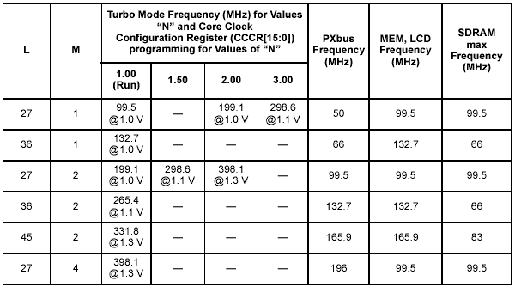
Xscale PXA 255 DVS setting

Slide 47
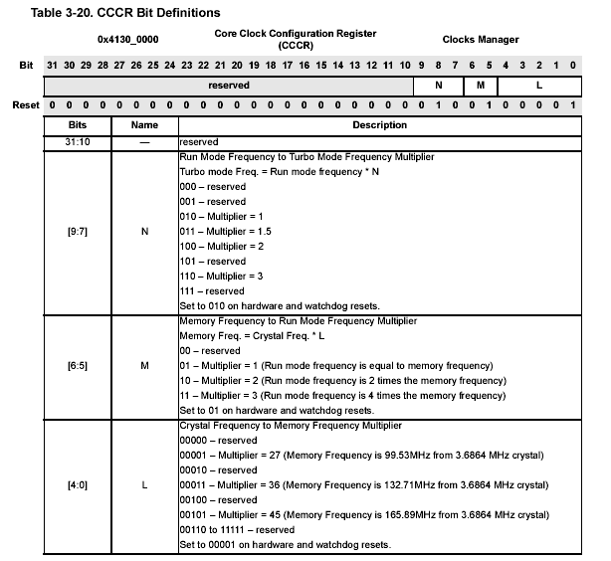
Xscale PXA 255 DVS setting
To run at 400Mhz:
N =
M =
L =
100
10
00001

Slide 48
Sample Code
// Step 1: Set the CCCR value
CCCR = Hz_to_CCCR( khz);
// Step 2: Enter the frequency change sequence
// MCR <co-pro>, <op>, <CPU reg>, <co-pro reg>, <co-pro reg2>, <op2>
// mcr: move contents of reqister r4 of the processor to
// Coprocessor 14, register 6.
__asm__ __volatile__(
"mov r4, #1 \n"
"mcr p14, 0, r4, c6, c0, 0 \n"
"mov r4, #3 \n"
"mcr p14, 0, r4, c6, c0, 0 \n"
:
:
: "r4");
// Step 3: Set/Reset the Turbo Mode bit
Enter turbo mode
Change Frequency

Slide 49
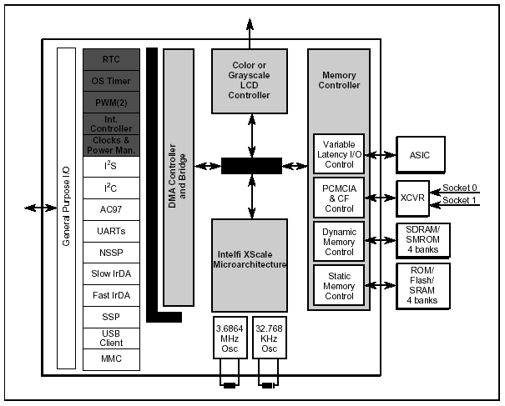
Embedded processor for mobile devices

Slide 50
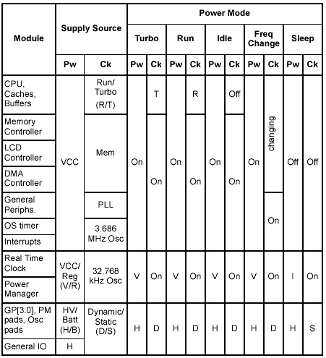
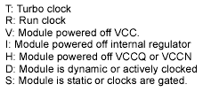
Power and clock supply sources

Slide 51
Energy Consumption by Memory
Mobile PC
Thermal Design (TDP) System Power
Mobile PC
Average System Power
Other
600/500 MHz uP
Other
600/500 MHz uP
13%
37%
13%
13%
Power Supply
Power Supply
10%
10%
Memory+Graphics
LCD 10"
12%
Memory+Graphics
30%
15%
HDD
9%
LCD 10"
HDD
19%
19%
Note: Based on Actual Measurements
Multiple Platform Components Comprise Average Power
CPU Dominates Thermal Design Power
[Courtesy: N. Dutt; Source: V. Tiwari]

Slide 52
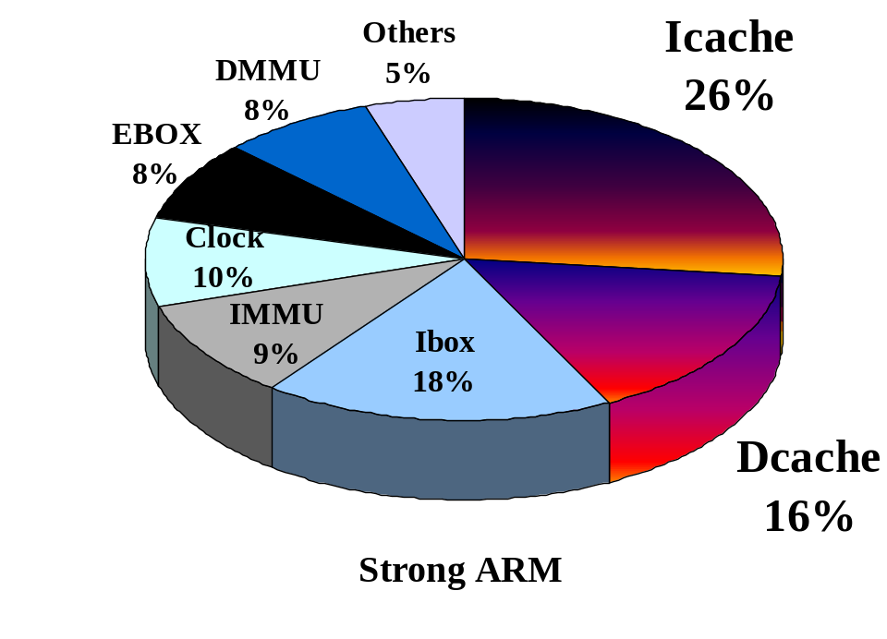
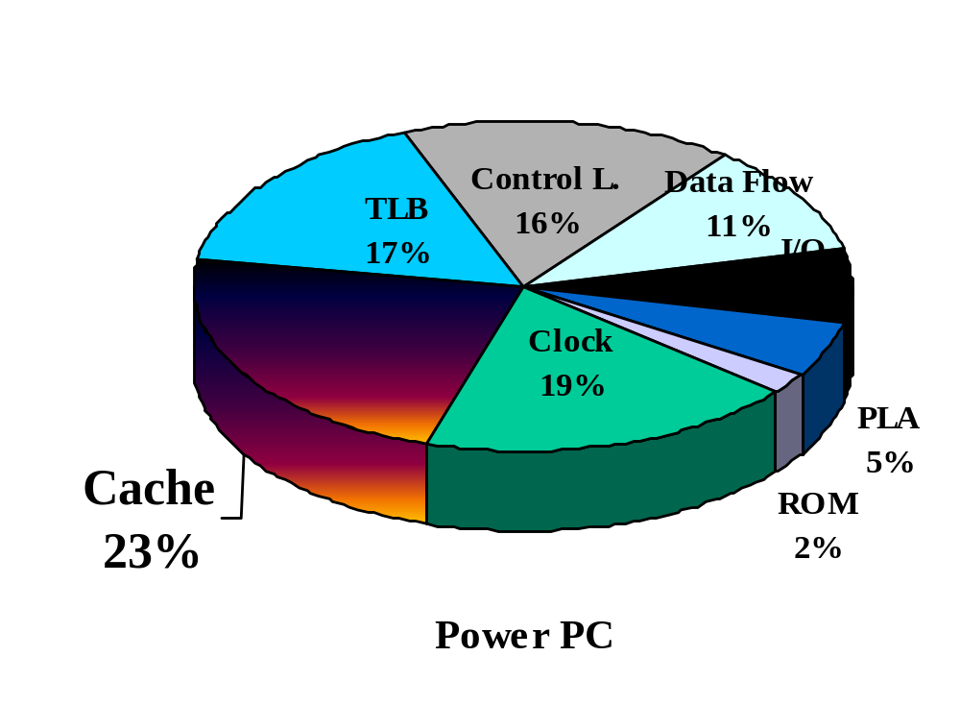
“CPU” Power Dissipation
42%/40% again memory-related !
IEEE Journal of SSC Nov. 96
Based on slide by and ©: Osman S. Unsal, Israel Koren, C. Mani Krishna, Csaba Andras Moritz, University of Massachusetts, Amherst, 2001
Proceedings of ISSCC 94

Slide 53
Adaptive caches – hardware
SRAM fabric
μP
1-way 4K
2-way 2K
4-way 1K
…
$ organizer
bus
Desired organization
$ reg.

Slide 54
Adaptive caches – software
Cache reorganized at run-time to reduce misses
  Reduced time to compute (T )
  Eliminate access to off-chip memory (P )
  Thus, reduce overall energy
  Improve tiling -> matrix operations
Requires cache aware compilers (static)
Requires cache aware OS (dynamic)

Slide 55
General remarks
Lot more of everything (networking, communication)
Lot less energy, volume, weight, patience
Programming context is changing (awareness of location, power, timing)
Awareness means strategies (DVS)

Slide 56
Embedded Processor Support for Low Power Design
Low power circuit design
  Minimizing the power supply voltage, Vdd
  Minimizing the circuit activities, A
  Minimizing the number of gates
  Minimizing the clock frequency, f

Slide 57
Embedded Processor Support for Low Power Design
Hardware low power strategies
  Minimize Vdd
  Minimize off-chip activity
  Minimize on-chip activity
  Exploit parallelism

Slide 58
Embedded Processor Support for Low Power Design
CAM: Content Addressable Memory
  Power hungry
Power optimization
  Off-chip accesses cost a lot more energy than on-chip accesses
  Design a good cache organization

Slide 59
Summary
In this lecture,
  we discussed how the energy consumption affects the embedded processors design,
  we discussed how the clock rate affects energy consumption, and
  we discuss how to change power mode and clock rate on Intel XScale processor.
In the next lecture,
  You will learn how to schedule the tasks such that the energy consumption is minimized and the system meets the requirements.

Slide 60
Questions ?

